Slide 1

The Potato Vendor DApp
A Decentralized Token Vending and Locker System

Slide 2
Overview
dApp for ordering potatoes online and delivery through a locker
Privacy Centric : use wallet instead of showing id or person interaction
Customer Centric : no gas fees to buy potatoes or to open a locker

Slide 3
PotatoToken Contract
a ERC20 potato stablecoin
Implements IERC20Permit to provide gasless allowance
Price tied to the price of a potato by the EATER DAO
It potatoes get to cheap, they eat a lot of potatoes from the supply
Otherwise the reverse

Slide 4
PotatoVendor Contract
Permit function calls the IERC20Permit.permit with signature and content and raises an event for the potato-daemon.
GetApprovedAmount transfers the potato allowed tokens to itself.
ReserveLocker assigns an available locker with the use of randomness and integer overflow.
OpenLocker opens the locker if user provides signed message of the locker number.

Slide 5
How It Works
BE/FE for buying potatoes on public internet
BE/FE for opening locker on wifi of embedded locker mgmt system
Daemon (TEE) to listen on events
BuyPotato : register email to buyer and reserves locker
LockerAssigned : send order confirmation to buyer with locker number
LockeOpened : send pickup confirmation to buyer

Slide 6
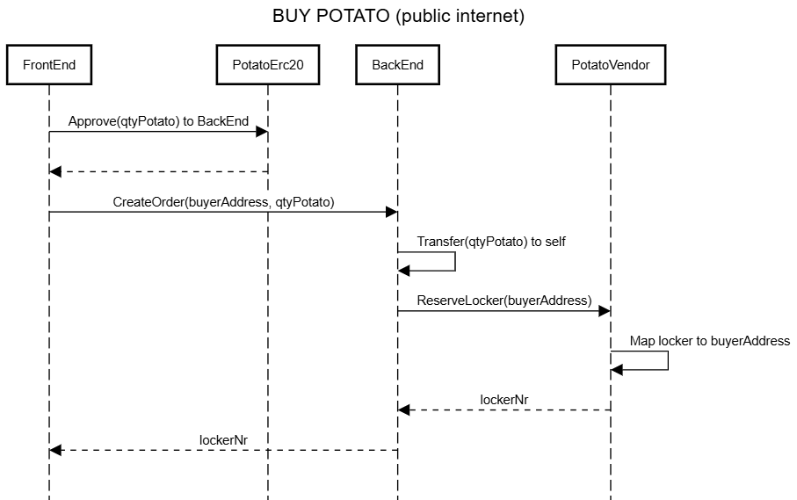
How It Works

Slide 7
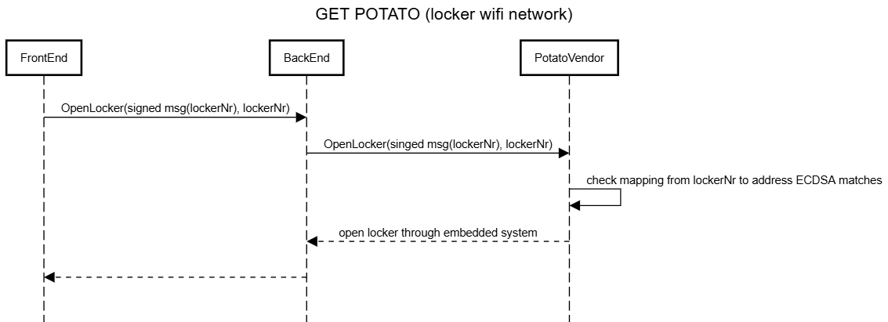
How It Works

Slide 8
Use Cases
Gasless purchases
Handling of goods for which privacy is paramount

Slide 9
Conclusions
EVM events can be used as Kafka / ServiceBus to a TEE
Use NestJS BE instead of scaffold-eth (time issue)

